Slide 1
CSP2104 Object-Oriented Programming in C++
Module 10
Understanding Inheritance

Slide 2
On the Agenda…
Class Inheritance
Create a derived class, and restrictions imposed with inheritance
Override and overload parent class functions within a child class
Provide for a base class constructor within a derived class
Using derived classes as base classes
Use Multiple Inheritance
Learn about the special problems posed by multiple inheritance
Use virtual inheritance

Slide 3
Understanding Inheritance
Terminology
Class A can inherit data and/or behaviour from another class (class B)
Class A inherits members’ data and or function from B
Class B is called a parent class, base class or superclass
Class A is called a child class, derived class or subclass
When any class member function is called
The compiler looks for a matching function in the class of the object using the function name
If no match is found in this class, the compiler looks for a matching function in the parent class
If no match is found in the parent class, it continues up the inheritance hierarchy, until the base class is reached
If no match is found in any class, an error message is issued

Slide 4
Inheritance Syntax
class A : access_modifier B {
// Usual member data & function declaration
};
This indicates that
A is a subclass of class B
access_modifier can be either
public, protected, private or virtual

Slide 5
Creating a Derived Class
class Person {
private:
int idNum;
string firstName;
string lastName;
public:
void setFields(int, string, string);
void outputData();
};
void Person::setFields(int num, string first,
string last) {
idNum = num;
firstName = first;
lastName = last;
}
void Person::outputData() {
cout << “ID #” << idNum << “ Name: “ <<
firstName << “ “ << lastName << end;
}
Notes:
We have a base class of Person with it’s data members and functions.
We have intentionally left out a constructor for the purposes of this example

Slide 6
Creating a Derived Class
class Customer : public Person {
private:
double balanceDue;
public:
void setBalDue(double);
void outputBalDue();
};
void Customer::setBalDue(double bal) {
balanceDue = bal;
}
void Customer::outputBalDue() {
cout << “Balance due $” << balanceDue
<< endl;
}
Notes:
Here we have a Customer class which inherits from the Person base class.

Slide 7
Creating a Derived Class
int main() {
Customer cust;
cust.setFields(215, “Linda”, “Santini”);
cust.outputData();
cust.setBalDue(147.95);
cust.outputBalDue();
return 0;
}
Inherited from the
Person() class
Customer() class

Slide 8
Understanding Inheritance Restrictions
Private members can be accessed only within a class
Protected members can be accessed only by class functions, or by functions in child classes
If we replace the previous outputBalDue() method with the following, it will no longer work
void Customer::outputBalDue() {
cout << “ID #” << idNum <<
“ Balance due $” <<
balanceDue << endl;
}
Inaccessible

Slide 9
Understanding Inheritance Restrictions
class Person {
private:
int idNum;
string firstName;
string lastName;
public:
void setFields(int, string, string);
void outputData();
int getID();
};
void Person::setFields(int num, string first,
string last) {
idNum = num;
firstName = first;
lastName = last;
}
void Person::outputData() {
cout << “ID #” << idNum << “ Name: “ <<
firstName << “ “ << lastName << end;
}
int Person::getID() {
return idNum;
}
Notes:
The solution to the private data issue on the previous slide is to implement an accessor method for that data member.

Slide 10
Understanding Inheritance Restrictions
class Customer : public Person {
private:
double balanceDue;
public:
void setBalDue(double);
void outputBalDue();
};
void Customer::setBalDue(double bal) {
balanceDue = bal;
}
void Customer::outputBalDue() {
cout << “ID #” << getID() <<
“ Balance due $” <<
balanceDue << endl;
}

Slide 11
Understanding the Class Access Specifier
Any of the following inheritance access specifier declarations are valid
class Customer : public Person
class Customer : protected Person
class Customer : private person
These determine the visibility from outside the Customer class.

Slide 12
Understanding the Class Access Specifier
Public inheritance
public, protected and private base class members remain as they are.
Protected inheritance
public base class members become protected
protected and private base class members remain as they are.
Private inheritance (default)
public and protected base class members become private
private base class members remain private

Slide 13
Overriding and Overloading Parent Class Functions
class Person {
private:
int idNum;
string lastName;
string firstName;
public:
void setFields(int, string, string);
void outputData();
int getID();
};
void Person::setFields(int num, string last, string first) {
idNum = num;
lastName = last;
firstName = first;
}
void Person::outputData() {
cout << “ID #” << idNum << “ Name: “ <<
firstName << “ “ << lastName << endl;
}
int Person::getID() {
return idNum;
}
Base class outputData() function

Slide 14

Overriding and Overloading Parent Class Functions
class Employee : public Person {
private:
int dept;
double hourlyRate;
public:
void setFields(int, string, string, int, double);
void outputData();
};
void Employee::setFields(int num, string last, string first,
int dep, double sal) {
Person::setFields(num, last, first);
dept = dep;
hourlyRate = sal;
}
void Employee::outputData() {
Person::outputData();
cout << “Department #” << dept << “ Pay rate $”
<< hourlyRate << endl;
}
Overridden outputData() function

Slide 15
Overriding and Overloading Parent Class Functions
You can use the Person version of a function in an Employee object by using the following syntax
worker.Person::setFields(id, last, first);

Slide 16
Providing for Base Class Construction
Constructors and Destructors
Constructors of a derived class call the constructor for the base class immediately, before doing anything else
Destructors of a derived class do their jobs first and then base class destructors are called automatically after
Example:
When the PetStoreAnimal constructor is called, it automatically calls PetStoreItem class constructor
This constructor requires arguments for stockNum and price, so those arguments have to be provided

Slide 17
Providing for Base Class Construction
class PetStoreItem {
protected:
int stockNum;
double price;
public:
PetStoreItem(int, double);
};
PetStoreItem::PetStoreItem(int stock, double cost) {
stockNum = stock;
price = cost;
}
class PetStoreAnimal : public PetStoreItem {
protected:
int petAge;
public:
PetStoreAnimal(int, double, int);
};
PetStoreAnimal::PetStoreAnimal(int stock, double price,
int age) : PetStoreItem(stock, price) {
petAge = age;
}

Slide 18
Copying from derived to base
Worker aWorker; …
Person aPerson = aWorker; causes each data member to be copied from aWorker to aPerson
Leaves off data for which the base class doesn’t have members (object slicing)
When calling a member function on aPerson, eg. aPerson.outputData(), the Person::outputData function will be called.
The reverse assignment (aDerivedInstance = aBaseInstance) cannot take place without overloading operator= (covered in future lectures)
To prevent object slicing, the data members need to be present in the base class.

Slide 19
Preserving Derived Behaviour
Consider:
class Animal
{
public:
void makeSound() { cout << "....\n"; }
};
class Cat : public Animal
{
public:
void makeSound() {cout << "miow...\n";}
};
class Dog : public Animal
{
public:
void makeSound() {cout << "woof woof...\n";}
};

Slide 20
Preserving Derived Behaviour
Now, lets say we want a collection of some animals:
Dog aDog; Cat aCat;
vector<Animal> collection2;
collection2.push_back(aDog);
collection2.push_back(aCat);
The above looks all good, but when we try to access our animals…
collection2[0].makeSound();
collection2[1].makeSound();
The Base class (Animal) version of the function gets called. Output to console: ….

Slide 21
Preserving Derived Behaviour
The problem is that Dog and Cat objects are being converted to Animal objects, loosing the derived version of the functions. This can be solved by using pointers instead:
Dog aDog; Cat aCat;
vector<Animal*> collection2;
collection2.push_back(&aDog);
collection2.push_back(&aCat);
But we seem to get the same problem!!!
collection2[0]->makeSound();
collection2[1]->makeSound();
The Base class (Animal) version of the function gets called. Output to console: ….

Slide 22
Preserving Derived Behaviour
The wrong function is still called, even though in memory we are storing Dog and Cat objects. This is because the class functions are not stored with the object.
By default C++ employs ‘early’ or ‘static’ binding of functions. This means that the version of the function which will be called is decided at compile time. Since collection2 is a vector of Animal pointers, the Animal version of functions will be called on whatever is stored in the vector.
Late binding on the other hand means that the function version that is called is decided at runtime, based on the actual object class that the object belongs to.
To get C++ to use late binding on a function, use the keyword virtual.

Slide 23
Preserving Derived Behaviour
Make the method in the base class virtual:
class Animal
{
public:
virtual void makeSound() { cout << "....\n"; }
};
class Cat : public Animal
{
public:
void makeSound() {cout << "miow...\n";}
};
class Dog : public Animal
{
public:
void makeSound() {cout << "woof woof...\n";}
};

Slide 24
Preserving Derived Behaviour
With makeSound a virtual method, the following will now work.
Dog aDog; Cat aCat;
vector<Animal*> collection2;
collection2.push_back(&aDog);
collection2.push_back(&aCat);
collection2[0]->makeSound();
collection2[1]->makeSound();
Output to console: woof woof…
miaow…

Slide 25
Preserving Derived Behaviour
Member function should be declared virtual when you will not know till run-time which version should be invoked.
E.g. If you are going to load a dictionary of noun and verb objects into a vector and don’t know which of the objects will be nouns and verbs until you actually read them in.
Or if you want to use the derived objects in functions that take a reference to the base type. Eg:
void makeItSpeak(Animal& an)
{
an.makeSound();
}

Slide 26
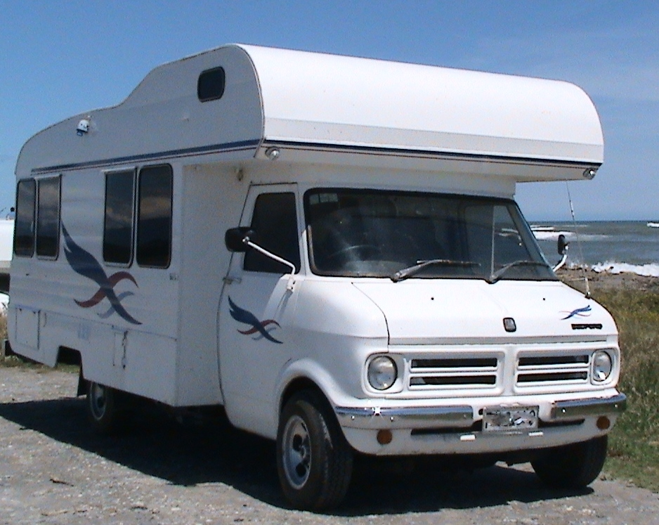
Using Multiple Inheritance
Single Inheritance
When a child class derives from a single parent
Multiple Inheritance
When a subclass inherits from more than one base class
Example: An RV is both a Dwelling and a Vehicle

Slide 27
Using Multiple Inheritance
class Vehicle {
protected:
int idNumber;
string make;
double milesPerGallon;
public:
Vehicle(int, string, double);
void display();
};
Vehicle::Vehicle(int id, string make,
double mpg) {
idNumber = id;
this->make = make;
milesPerGallon = mpg;
}
void Vehicle::display() {
cout << “ID #” << idNumber << “ Make: “
<< make << “ gets “ << milesPerGallon
<< “ miles per gallon” << endl;
}
class Dwelling {
protected:
int numberOfBedrooms;
int squareFeet;
public:
Dwelling(int, int);
void display();
};
Dwelling::Dwelling(int bedrooms,
int sqFeet) {
numberOfBedrooms = bedrooms;
squareFeet = sqFeet;
}
void Dwelling::display() {
cout << numberOfBedrooms <<
“ bedrooms and “ << squareFeet
<< “ square feet” << endl;
}

Slide 28
Using Multiple Inheritance
class RV : public Vehicle, public Dwelling {
public:
RV(int, string, double, int, int);
void display();
};
RV::RV(int id, string make, double mpg, int bedrooms,
int sqFt) : Vehicle(id, make, mpg),
Dwelling(bedrooms, sqFt) { }
void RV::display() {
cout << “A recreational vehicle: “ << endl;
Vehicle::display();
Dwelling::display();
}

Slide 29
Disadvantages of Using Multiple Inheritance
If two parent classes contain members with the same name, you must use the :: operator when working with those members
The Diamond Inheritance problem.

Slide 30
Using Virtual Base Classes
When using multiple inheritance, if the two parents both also have a parent in common we are presented with the Diamond Inheritance Problem
The base class will be inherited twice
To avoid this duplicate inheritance, use “virtual” as the class access specifier

Slide 31
Using Virtual Base Classes
Syntax of a virtual inheritance for each class
class Student : virtual public Person
class Employee : virtual public Person
class StudentEmployee : public Student, public Employee
Alternate syntax
class Student : public Person
class Employee : public Person
class StudentEmployee : virtual public Student, virtual public Employee

Slide 32
Using Virtual Base Classes
Handling constructors with multiple inheritance can be complicated if all involved classes have their own data members
Example: If Person requires values for ID number and name, Student requires a grade point average, Employee requires an hourly rate and StudentEmployee requires a limit on the number of hours allow to work per week, the constructor would look like…

Slide 33
Using Virtual Base Classes
StudentEmployee::StudentEmployee(int idNum, string name,
double gradePoint, double hourlyRate, int workHoursLimit)
: Person(idNum, name), Student (gradePoint),
Employee(hourlyRate) {
this->workHoursLimit = workHoursLimit;
}

Slide 34
Avoiding Multiple Inheritance
A derived class that inherits from just one class is easier to understand, easier to test, and less prone to error.
Instead of:
class RV : public Vehicle, public Dwelling {
};
Could implement the same functionality with:
class RV : public Vehicle {
Dwelling theDwelling;
};
Or with:
class RV {
Dwelling theDwelling;
Vehicle theVehicle;
};

Slide 35


